Slide 1
Lecture 2: HTML

Slide 2
HTML: Questions over reading
CH 3 - Basic HTML Structure
HTML Structure?
Parts of a document
<header>, <footer>, <aside>?
Naming elements
Classes
CH 6 - Links
Block Level Links
Wrapping elements in anchor tag
Target Attribute

Slide 3
HTML: Last Week Review
Hyper Text Markup Language
Think of as a Skeleton
Holds everything together
Cascading Style Sheets
Think of as Clothes
Styling of website or rather the presentation
JavaScript
Think of as Muscles
Creates functionality

Slide 4
HTML: This week overview
What is HTML
Brief history of HTML
Atom Text Editor
Hello World HTML page
HTML Tags
Semantic HTML

Slide 5

How the Internet Works
VIDEO LINK

Slide 6
HTML: What is it?
Hyper Text Markup Language
NOT a programming language
Foundation for building websites
The driver of content NOT presentation
HTML doesn’t define how things look, that’s for CSS
Meant to be accessible
Web Browsers are designed to render HTML for users
Files must end in .html
“index.html” is the root or homepage
HTML is a text document containing “markup”.
Markup describes the meaning
Meaning is the Semantics
HTML is a requirement
New front end frameworks like Angular and ReactJS require HTML but in different ways
Angular Example
React Example
Ruby on Rails Example

Slide 7
HTML: Web Pages
A web page consists of 3 primary components
Text Content - bare text that tells the user what your page or site is about
References to other files - items such as images, audio, video files or other HTML files
Assets - JavaScripts or CSS files
Markup - HTML Elements
These files are all saved as text so they can be universally read by browsers
There is other information contained in the files not viewable by users
Content in the <head>...</head>
The <head> contains character encoding usually UTF-8 and other information for the browser and search engines

Slide 8
PUPPIES!!!!

Slide 9
History of HTML

Slide 10

HTML: History
There is a great YouTube resource called DevTips. DevTips has been around for many years and has invaluable information. That we will periodically use in this course
There’s a multi part series that was done by DevTips as an overview to HTML. Watch the complete list at your leisure for some great insight but let’s take a look at the first couple of videos
DevTips HTML5 Basics Playlist:
History of HTML
Philosophy of HTML5
The DOM
Tags
Display Types
HTML5 Tags

Slide 11
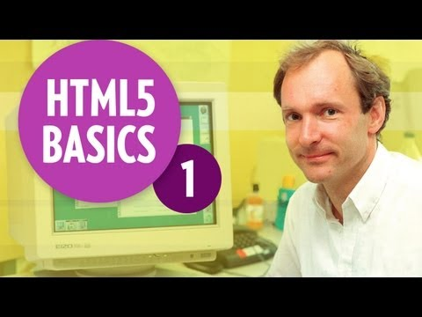
HTML: A brief history of
VIDEO LINK

Slide 12
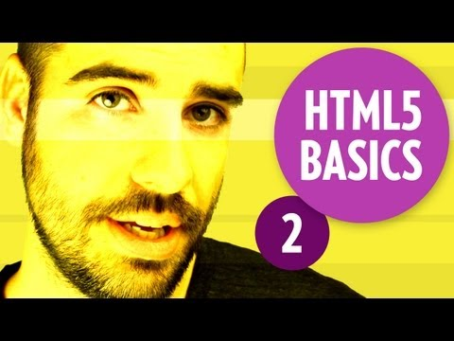
HTML: Philosophy of HTML5
VIDEO LINK

Slide 13
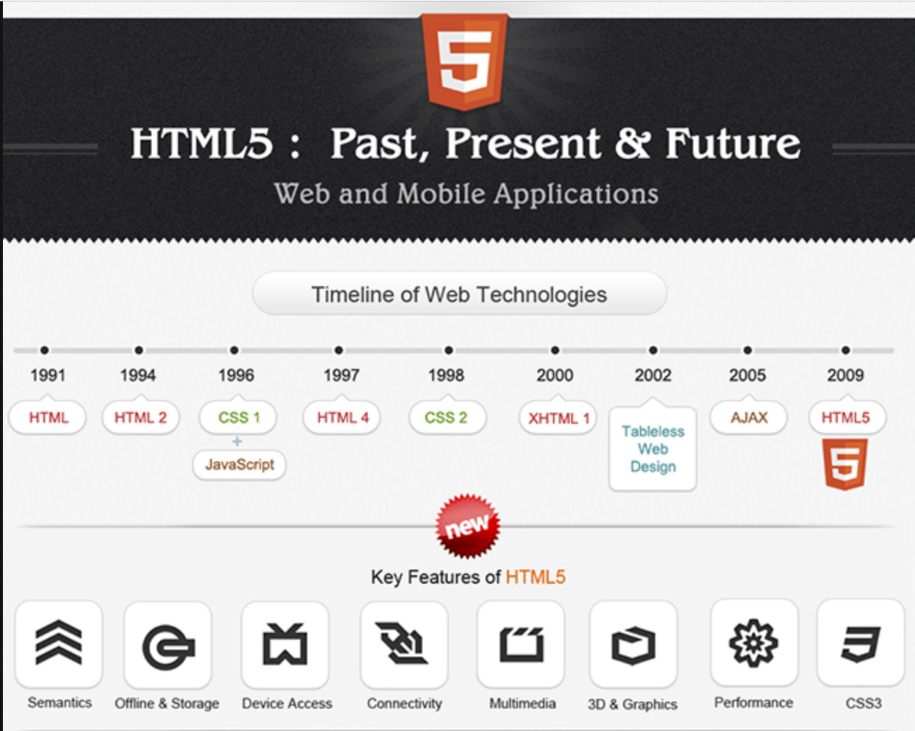
HTML: History Summary
Infographic: HTML5: Past, Present & Future.

Slide 14

Atom Text Editor

Slide 15
HTML: What is a text editor?
A text editor (TE) is like a word processor (WP) but vary in important ways
TEs are used for writing and editing code files
WPs are designed to format text for presentations
TEs are plain text
WPs have hidden code to run them

Slide 16
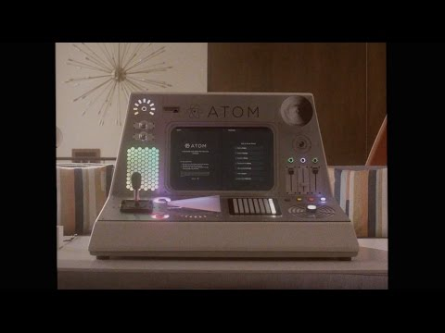
HTML: Welcome to Atom!
VIDEO LINK

Slide 17
HTML: OPEN ATOM!
OPEN ATOM!
Fun Facts:
Released in 2014
Free and Open Source
Supports
Plugins
Themes
Supports most major languages
Very Extensible and hacker friendly
Uses a lot of the same technology used in building modern applications like HTML, CSS, and JavaScript

Slide 18
HTML: Why does my Atom look different?
Answer: I use a lot of Plugins and Themes
Helpful Atom Packages/Themes can be found in the GitHub Repo

Slide 19
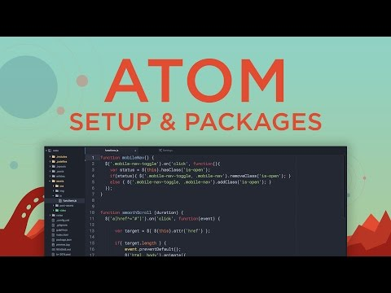
HTML: Atom Themes & Plugins
VIDEO LINK

Slide 20
Create our first HTML Page

Slide 21
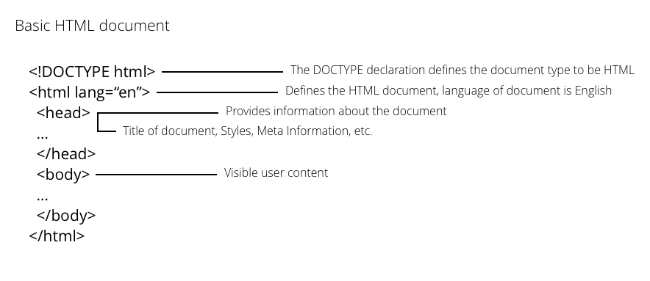
HTML: Document
HTML documents have a few HTML tags that are required
<!DOCTYPE>
<html>
<head>
<body>

Slide 22
HTML: Hello World
Open Atom in New Window
Type out an HTML document
Save as index.html
Open the index.html file by double clicking
Notice the URL when you double click the file “file:///Users/name/location/index.html”
This means your file is being served on the local file system
Make an edit to your file
Save your file
Reload your browser
What we’ve done is create our first HTML file. Opened it in the browser, made a change and got to see that change take place.

Slide 23
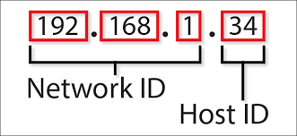
HTML: Hello World using a Server
The way the internet works is that a Client will make REQUESTS to a Server and the Server will send back RESPONSES.
Servers don’t have to be somewhere else we can actually do it on our own computer for a better development experience.
Click Atom > Preferences or cmd + ,
Click Install in Settings tab
Make sure “Packages” is highlighted
Search for “atom-live-server”
Click install
Go back to your index.html tab
Click Packages > atom-live-server
This will start a server on 127.0.0.1:3000
Make an edit to your index.html & save
Your browser should autoreload your changes

Slide 25
HTML: Hello World using a Server Breakdown
Ok so you may be asking yourself, what is going on? Simply put the package we are using is running some JavaScript behind the scenes that when we make changes to the file it will tell the browser to refresh itself.
This is one of the many time saving tools available while developing. The other added benefit is that we are able to test our code in a real browser.
For fun copy the URL or type in 127.0.0.1:3000 into FireFox and or Safari and you should see the same page. Now you can test your code in different browser all in real time if you wanted.
Fun fact 127.0.0.1:3000 is the same as typing localhost:3000

Slide 26
HTML: Help Resources
StackOverflow - HTML
W3Schools
HTML Cheatsheet

Slide 27
HTML: What is a tag?
An HTML tag is anything that resembles <tag>...</tag>
<h1>Hello World</h1>
What opens must close unless it is a special Self Closing Tag:
<img src=”...” /> or <br />
Tags are surrounded by angle brackets
Come in pairs, what you open you must close
Some tags are self closing

Slide 28
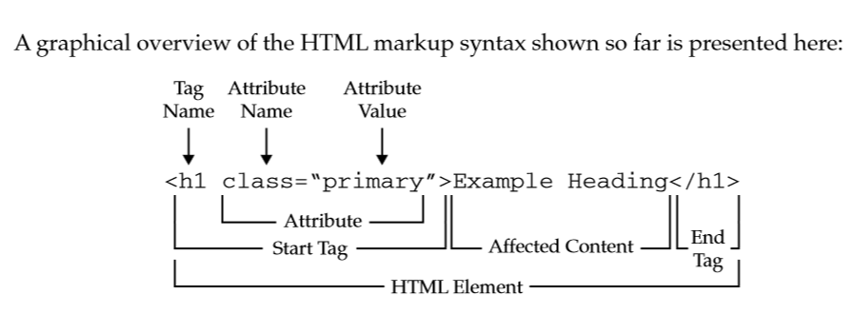
HTML: Tag Breakdown

Slide 29
HTML: Experiment with Tags
Let’s together start writing some tags and watch what happens in the browser
Headers: h1 - h6
Paragraph: p
Span: span
Anchor: a
Image: img
Unordered Lists: ul
Ordered Lists: ol
You will notice that some elements render on new lines and other elements render inline. This concept is Inline vs Block Level Elements
Inline Elements:
Do not start on a new line
Only as wide as needed
Block Elements
Start on new line
Full width
Full list of Inline and Block Elements

Slide 30
HTML: Tag Attributes
<tag attributename=”attributevalue”>...</tag>
<a href=”http://google.com”>Link to Google</a>
Tags can have one or more attributes attached to them
Some tags have specific attributes
Attributes are always used with the start of a tag
Are show in Key Value pairs key=”value”

Slide 31
HTML: Week 2 Homework
Homework
Read: Ch 7 & 8
Wireframes
Media
Merch
Tour Dates
Practice Coding
Make an index.html file
Practice tags
Use attributes on your tags
Lists, Paragraphs, Headers
Test out Atom Plugins and Themes

